Slide 1
The Direct Care Worker’s Role in Identifying and Addressing Pain in Older Adults
Funded by a grant from The SCAN Foundation
Developed by
Linda J. Redford, R.N., Ph.D
University of Kansas Medical Center
In collaboration with Aging Services of California, Sacramento, CA and LeadingAge Center for Applied Research, Washington, D.C.

Slide 2
What You Can Do to Help a Resident Who is Experiencing Pain
Module 2

Slide 3
At the end of this session, you will be able to--
List two misconceptions about nondrug approaches to pain.
Describe at least four nondrug approaches to relieving pain.
Discuss when and when not to use specific nondrug approaches.
Discuss barriers to use of nondrug approaches in managing pain.

Slide 4
Nondrug Therapies for Pain
Physical
Positioning
Exercise
Heat
Cold
Massage
Vibration
Psychosocial
Distraction
Music
Relaxation
Imagery
Comfort food
Controlled breathing
Notes:
There are a number of nondrug therapies that can be helpful in relieving pain. Most of the therapies shown above can be used without extensive training. While therapies such as massage therapy and music therapy do require specialized training for some applications, education on the basic principals of both will allow aides to utilize these therapies.
NOTE: These approaches to pain management should only be used with the knowledge and consent of the nurse in charge. In some cases, an order from the primary care provider will be needed.

Slide 5
Misconceptions About Nondrug Therapy
Wrong
Nondrug therapies are substitutes for drug therapies.
Right
Nondrug therapies are used alone only if they are effective in relieving the pain. Usually it is necessary to use appropriate pain drugs along with nondrug therapies.
Notes:
In the next few slides, we review some common misconceptions about nondrug approaches to relieving pain.

Slide 6
Misconceptions About Nondrug Therapy
Wrong
If distraction relieves pain, the pain isn’t “real”.
Right
Distraction is a very effective strategy for relieving some types of pain.
Distraction helps pain medication work more effectively by helping the person relax.

Slide 7
Misconceptions About Nondrug Therapy
Wrong
Nondrug therapies don’t work for serious pain.
Right
Nondrug therapies do work for serious pain, especially when combined with appropriate medications.

Slide 8
Approaches to Nondrug Therapies
Notes:
Next we are going to discuss some of the common nondrug approaches to pain management.

Slide 9
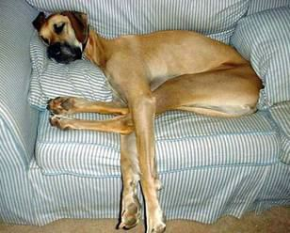
Positioning
Make certain --
not lying on a wrinkle in the bed or seat,
not lying against a sore extremity,
body aligned properly,
not left too long in the same position.
Notes:
At the beginning of this slide, have everyone cross their legs and sit completely still until told to move. (Excuse those who cannot participate for medical or other reasons.) Set a timer for ten minutes. When the timer goes off, ask everyone if they are uncomfortable. Have them imagine what they would feel like if left in the position for two or three hours.
Positioning is critical to resident comfort, protection of the skin, and for preventing and alleviating pain.
For people who are unable to shift their position themselves, even sitting or lying on small wrinkles or lumps can cause pain and skin breakdown within a very short period. Keep surfaces smooth and adjust the person’s position often (at least every 2 hours and more frequently if discomfort or redness of the skin is evident). Any position can become uncomfortable after a time.
Never sit or lay a person in a position that will put pressure on a sore extremity or other part of the body. Support sore extremities with pillows if this provides comfort.

Slide 10
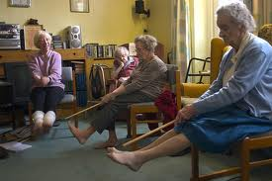
Exercise
Movement can relieve pain.
Keeps joints moving.
If it causes worsening of the pain, DON’T DO IT.
Notes:
Although movement can sometimes cause discomfort, it is important to move joints to keep them from becoming stiff and immobile and to improve circulation and overall well-being of the individual. A physical therapist can work with you to find exercises that will be helpful and safe for each individual. Encouraging the resident to do as many personal care tasks as possible, to walk to activities if able, and to participate in scheduled activities is a start in increasing exercise.

Slide 11
Cautions with Exercise
Get approval of the medical provider to do exercises.
Work with a physical therapist in identifying appropriate exercises.
STOP if pain increases.
Notes:
Encouraging usual daily activities is generally fine, but conducting exercises that place more stress on painful areas of the body should have medical approval. If your goal is to reduce pain through exercise, it is wise to seek the help of a physical therapist in identifying useful exercises.

Slide 12
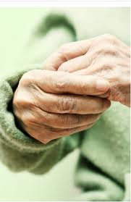
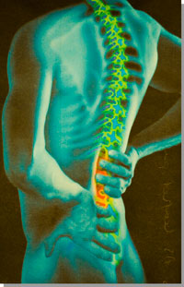
Heat
Heat is best used for chronic pain. It helps to relax muscles, ease discomfort in sore joints, increase blood flow to muscles, and increase flexibility.
Notes:
Older adults tend to be more likely to accept the use of heat than cold. Heat does have a place in the treatment of pain, but may not be as effective as cold in many situations. We will discuss approach to introducing “cold” to your residents in a later slide.

Slide 13
Heat
Can use warm towels, hot water bottle, or heating pad as a source of heat.
Heat should be between 104 and 113 degrees Fahrenheit. USE A THERMOMETER TO CHECK TEMPERATURE BEFORE APPLYING.
Notes:
Only use heating devices approved by your organization and make certain they are within the acceptable heating range before applying to the skin.

Slide 14
Cautions When Using Heat
DO NOT APPLY HEAT DIRECTLY ON SKIN.
Place a towel or thick cloth between the heat source and the skin.
Do not apply for more than 20 minutes at a time.
Notes:
Placing a heating pad or other source of heat directly to the skin can result in damage to the skin. This is particularly the case in frail older adults whose skin is very thin and fragile. Applications of heat for more than 20 minutes at a time has no added value and can result in skin damage. Wait an hour between applications.

Slide 15
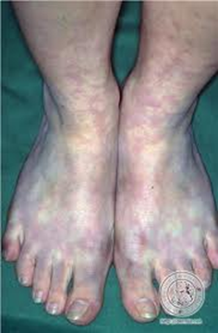
Cautions When Using Heat
DO NOT use heat on a new injury or immediately after exercise.
DO NOT use heat on a person with decreased blood flow to an area or decreased ability to feel heat or cold.
Notes:
Heat applied to new injuries will increase the inflammatory response and result in additional swelling and possibly more extensive bleeding. Likewise use of heat after exercise will do more harm than good. Heat applications to muscles that are already warm and stressed will only increase swelling in the muscles and increase discomfort.
Heat should never be applied to an area where there is decreased blood flow. You can tell by the blotchy skin on the feet in the picture above that this person has a reduced blood flow to the legs and feet. This person would be more susceptible to burns from heat since feeling in the legs and feet is likely to be reduced. In addition, heat can damage the tissue in areas with a decreased blood supply.

Slide 16
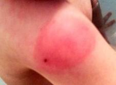
Cautions When Using Heat
DO NOT use heat on an area that is newly inflamed (red, swollen, warmer than the surrounding area)
Notes:
Heat should not be used on areas that are newly red, swollen, and warm to the touch. Heat will make inflammation worse. It can be used at very low temperatures on chronically inflamed joints (arthritis) and stiff muscles.

Slide 17
Cautions When Using Heat
DO NOT use heat when a person is sleeping.
DO NOT use heat with person lying on top of the pad (pressure increases heat).
DO NOT use heat if has certain health conditions.
IF PAIN INCREASES, STOP USING HEAT!
Notes:
Using a heating pad or other source of heat on a person who is sleeping can result in burns. In addition, a person should NEVER lay on top of a heating pad. Pressure from the body intensifies the heat and can cause burns.
Anytime there is an increase in pain or discomfort with the use of heat, STOP IT and have the problem evaluated by the resident’s primary care provider.
There are also certain health conditions in which heat should not be used. Always have consent from the resident’s primary care provider and the nurse in charge before using heat applications.

Slide 18
Cold
Reduces pain by-
Decreasing inflammation
Numbing nerve endings
Reducing muscle spasms
Reducing swelling
.
Notes:
Cold is very effective in reducing some kinds of pain– particularly pain caused by inflammation, irritated nerves, muscle spasms, and swelling.

Slide 19
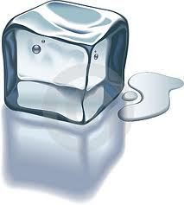
When to use “cold”
New (acute) injuries—not if skin is broken.
Chronic pain (like arthritis)- if it helps.
To massage sore joints.
To reduce desire to scratch areas that itch.
Notes:
Cold has several uses and should be used first if there is a question about whether to use heat or cold.

Slide 20
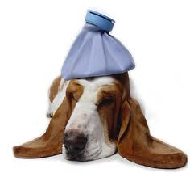
Advantages of “Cold”
It is more effective in relieving many kinds of pain, particularly pain from irritated nerve endings and pain from inflammation.
It works more quickly in relieving pain.
The effects last longer.
Notes:
Cold dulls the nerve endings and reduces the feeling of pain as well as reducing the swelling that occurs with inflammation. It is the swelling of tissue that exerts pressures on surrounding nerves and structures and causes some of the pain with new injuries.

Slide 21
Cautions When Using Cold
DO NOT APPLY COLD DIRECTLY ON SKIN.
Place a towel or thick cloth between the ice pack and the skin.
Do not apply for more than 20 minutes at a time.
Notes:
As with heat, cold directly applied to the skin can cause damage. Always use a cloth between the cold pack and the skin. It has also been shown that there is no added value of leaving a cold pack in place for more than 20 minutes and it can, in fact, cause skin damage if left for longer periods.

Slide 22
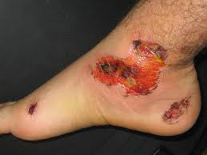
Cautions When Using Cold
DO NOT use cold on an open wound.
DO NOT use cold on severe injuries.
Notes:
As with heat, there are times cold should not be used. The list on this slide shows conditions under which cold applications should not be used. Always have consent from the resident’s primary care provider and the nurse in charge before using cold applications.

Slide 23
Cautions When Using Cold
DO NOT use cold on areas being treated with radiation.
DO NOT use cold on areas with poor circulation.
Notes:
The skin in areas receiving radiation is very fragile and easily damaged. Never use cold or heat on these areas. If cold is applied to areas with poor circulation it will further compromise blood flow to the area and is likely to cause additional pain.

Slide 24
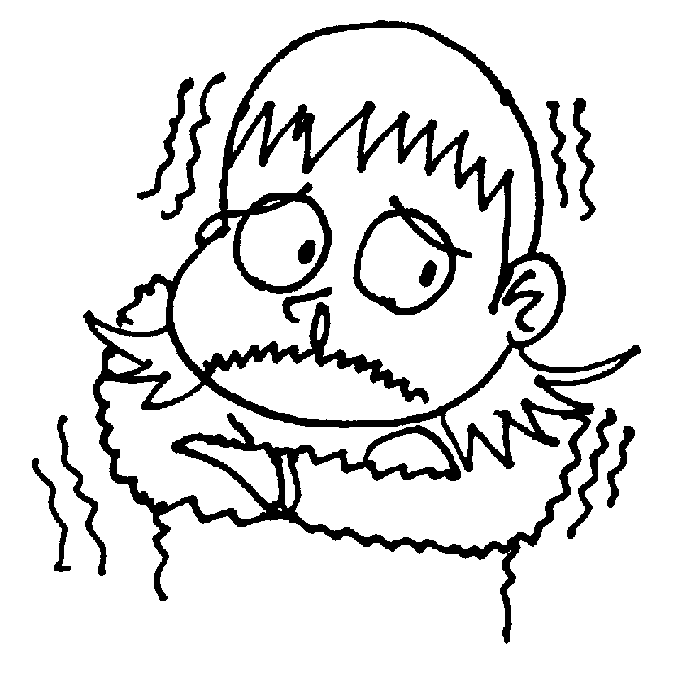
Cautions When Using Cold
DO NOT use cold with certain health conditions.
DO NOT use cold if the individual is highly sensitive to cold.
Notes:
Ice should not be used on the extremities in people with peripheral vascular disease, Raynaud's Syndrome, and other conditions that make them sensitive to cold. In some cases, people do not tolerate cold on any part of their body and will not do well with the use of ice. Anytime a person begins to shiver, stop the use of ice.

Slide 25
Massage
Enhances relaxation.
Relieves painful muscles.
Is safe if used appropriately.
Provides human touch.
Is an inexpensive intervention– unless using a trained therapist for advanced techniques.
Notes:
Massage has many benefits and can be used safely in most older persons. One of the most important aspects of massage is that it provides human touch which is important to the well-being of most people.

Slide 26
Types of Massage
Lightly massaging hands with warm lotion.
Soaking feet in warm (not hot) water and lightly rub.
Notes:
Some people are not comfortable with back or shoulder massages, but do find hand and foot massages relaxing. Hand massages are best done with warm lotion while foot massages can be done in warm water or with lotion. Remember that the joints of older people are often tender. Use light pressure when massaging hands or feet and watch for signs that it is causing the person discomfort.
Ask participants to select a partner and have them practice hand and foot massages on each other. Provide basins of warm water to soak feet while conducting hand massages. Warm lotion and go through the same procedure that should be used with residents.

Slide 27
Types of Massage
Lightly massaging shoulders to relax sore muscles.
Massage back lightly with warm lotion at bedtime or when the person is becoming anxious.
Notes:
Massaging the shoulders reduces tight muscles from sitting in uncomfortable positions or using arms for repetitive activities. Back massage reduces tension and promotes sleep when used near bedtime. Both types of massage are relaxing and can calm residents who are becoming agitated.
Have participants stand in a circle with their backs to each other. Have each participant massage the shoulders of the person in front of them for 2 to 3 minutes. Ask for their comments.

Slide 28
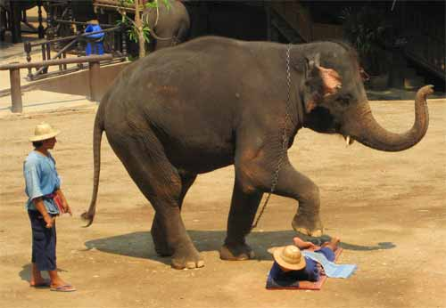
Cautions with Massage
DO NOT massage over broken skin.
DO NOT use vigorous strokes or hard pressure.
Notes:
Massage in older persons is not the same as that used for athletes and younger adults. When you are massaging an older person, you must be much more gentle. The skin of older persons is thinner and much more prone to tearing. Light strokes with minimal friction is important when massaging older skin. Always use powder or warm lotion to reduce friction. Also remember not to use hard pressure. The bones of older people are often more fragile and their joints are likely to be tender from arthritis.

Slide 29
Cautions with Massage
DO NOT massage lower extremities without a doctor’s order.
DO NOT massage over areas of tumors or bone metastases.
DO NOT massage areas that are red and unusually warm to the touch.
DO NOT use if it makes resident uncomfortable.
STOP if pain gets worse!

Slide 30
Distraction
The purpose of distraction is to divert person’s attention away from their pain.
Notes:
Ask participants- “Think about the times you have had pain. Did it seem to hurt more when you had nothing to do but think about it?” Give participants a few seconds to think and ask them to relate some of their experiences with pain.
When people have nothing to do but sit or lay and think about their pain, it is likely to intensify the pain. Sometimes the sensation of pain can be relieved somewhat by helping people focus on something else. The pain may not go away, but it may be more bearable.

Slide 31
Distraction
Approaches to distracting a resident who is in pain.
Look at pictures with the resident.
Talk about events that interest the resident.
Play music.
Use various relaxation techniques.
Notes:
Distraction requires finding something that will divert the person’s attention from his or her pain. Because you can divert attention from the pain does not mean they are not in pain.

Slide 32
Imagery
Approach to doing guided imagery.
Encourage the person to imagine a place or setting they love. If needed, show them pictures of scenes that are calming and peaceful. Have them imagine they are in the picture.
Ask them to describe the sounds, the sights, the smells…
Notes:
Having the resident imagine being in a place they love or a type of setting they have enjoyed during their lifetime can distract them from their pain and help them relax. Have the person imagine a place they loved to visit (the ocean, the mountains, an open field, etc.). In some cases, it may help to show them a picture and have them imagine they are in the picture. Encourage them to talk about what the would see, hear, smell, feel and taste.
Have participants break into pairs and take turns playing the resident. Give each pair some pictures and have them practice using the imagery technique.

Slide 33
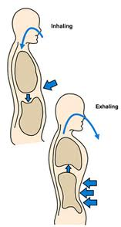
Deep Breathing
Slow, deep breathes-relax the body, reduce stress, and serve as a distraction.
Approach to deep breathing-
Breathe from the abdomen.
Take in a slow, deep breaths, hold breath
to the count of 4, and let it out.
Breath in through the nose
and out through the mouth.
Do not use if deep breaths increase
pain.
Notes:
Deep breathing has long been known to reduce stress and help people relax. It also serves as a detraction from pain. Teaching people how to do deep breathing is relatively easy, but residents who are in pain may need to be coached.
Have participants break into pairs and coach each other in this technique.

Slide 34
Progressive Muscle Relaxation
Helps relieve stress and promotes relaxation.
Residents may need to be coached in conducting this exercise.
Approach to progressive muscle relaxation-
Start with one part of the body, usually a foot.
Have the resident tighten the muscles in the foot and hold it to the count of 10.
Have them slowly relax the muscles in the foot and feel the tension melt away.
Continue this with the other foot, the leg, the buttocks, and other muscle groups working up to the face.
Notes:
This type of exercise requires that the resident be able to understand and respond to what you are asking him or her to do. It also requires that the resident have the energy to do the exercise and that contracting muscles does not increase pain. This exercise is particularly helpful for those with psychic pain more so than physical pain.
Have the participants break into pairs and coach each other in progressive muscle relaxation. Use the handout as a guide.

Slide 35
Distraction
Considerations/precautions
Most effective for mild pain if used alone.
Most effective for moderate to severe pain if used with a pain medication.
Do not doubt that the person is in pain just because they can be distracted.
The effect is not likely to last for a long period.
Notes:
Distraction may relieve minor pain alone, but will need to be used in conjunction with pain medication for moderate to severe pain. The importance of distraction is that it helps relax the person and gives the medication a better chance of being effective. The fact that the person’s attention can be switched to another activity does not mean the person is not in pain. The mind can better deal with pain if it is not focused only on the pain sensation. It is unlikely that the effect of distraction will last much past the intervention, but it may give medication time to reduce the pain.

Slide 36
Music
Music is used to—
encourage emotional expression
relieve pain
provide an overall sense of well-being
relieve stress
http://www.youtube.com/watch?v=aPRkgkZHjqI
Notes:
Pain can have emotional roots as well as physical causes. Music may allow people to express their feelings and relieve pent-up emotions. Music also provides an effective distraction to reduce pain, particularly if the music is carefully chosen to address the individual’s taste in music. Music has the power to move the body and the mind as is illustrated on the video.
If you have an Internet the connection, you may want to show Video #6 (Resource Section) on Music Therapy. http://www.youtube.com/watch?v=aPRkgkZHjqI

Slide 37
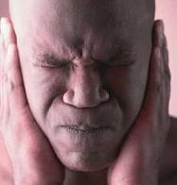
Cautions in the Use of Music
Taste in music is very individual.
It the music is distasteful to a person, it can increase agitation and discomfort.
Notes:
Make a DVD with a mix of different music mix. Make certain the DVD contains a wide variety of music types– classical, gospel, country western, rock, rap, heavy metal, oriental, and Indian drums. After playing a brief segment of each kind of music, stop and ask participants-
“How did that music make you feel?”
“Would that music be comforting to you if you were in pain or were upset?”

Slide 38
Pet Therapy
Animals can both distract and calm persons in pain, helping them to relax.
Notes:
The calming affect of animals has been documented in several studies. The person’s own dog, cat or other pet is often a comfort to the person who is in pain. Well-trained and loving animals can provide company, comfort, and warmth.

Slide 39
Other Forms of Nondrug Therapy
Vibration
Can help with chronic muscle pain.
Comfort foods
Bring back good memories.
Help relax and calm person.
Notes:
Vibration can be helpful in relaxing tight muscles and relieving soreness. It should be used with the same precautions as massage.
Comfort foods are those foods that we have associated with pleasant memories throughout our lives. They can be particular helpful for those who are still able to swallow and enjoy food.
Have participants name some foods that are comfort foods for them.

Slide 40
Nondrug Pain Interventions
Advantages
Gives resident feeling of more control and involvement.
Fewer potential side effects.
Improves response to pain medication.
Used with medications unless effective alone.
Generally lower cost than drugs.
Adapted from Ersek, M. (2003). Strategies to Enhance Pain Management in Nursing Homes. Swedish Medical Center.

Slide 41
Nondrug Pain Interventions
Disadvantages
Sometimes time-consuming.
Some therapies require extensive training.
Staff or resident may be unwilling to try.
Think it won’t help.
Think it will be done instead of giving medication.
Adapted from Ersek, M. (2003). Strategies to Enhance Pain Management in Nursing Homes. Swedish Medical Center.

Slide 42
Nondrug Pain Interventions
Disadvantages (continued)
Some techniques do not work or should not be used with certain residents (e.g. cognitively impaired and those with certain medical conditions).
Notes:
Activities that require the person to understand what is said and follow directions cannot be used effectively with people who have severe cognitive deficits, cannot understand or respond to verbal directions, or have a condition that limits their ability to do the activity.

Slide 43
Nondrug pain management strategies are a critical part of a good pain management program.

Slide 44
Anytime a resident appears to be in severe pain, report it to the nurse immediately. Do not attempt any interventions.

Slide 45
If resident is in mild to moderate discomfort, check for and attempt to remedy the cause of the discomfort. If ineffective, report observations to the nurse.

Slide 46
What to do if you think a resident is having pain-
Gather as much information as possible.
Report specific signs of pain to the nurse.
Try simple and safe nondrug strategies- divert attention with conversation, singing, repositioning, touch.
Document what you see.
Document what helps.
Notes:
If a resident you are caring for has pain, gather as much information as possible and report it to the nurse. If the resident is able to answer, ask the questions shown earlier– the intensity, location, type, duration, what helps and what makes it worse?

Slide 47
QUESTIONS?

